Slide 1

IILM UNIVERSITY
Summer Internship Presentation
AgriConnect: Smart Agribusiness
Management & Marketplace Platform
Architecture Design and Prototype Development
STUDENT NAME
ENROLLMENT NO.
PROGRAM & SEMESTER
ORGANIZATION
Anish Kumar
YI/2026/183999/408535
B.Tech, 3rd Semester
Yuva Intern
Internship Duration: Week 2 – Week 3 | Focus Area: Software Architecture, Backend Prototyping & Unit Testing

Slide 2
OVERVIEW
Presentation Agenda
01
About AgriConnect
02
Architecture Principles
Problem context and platform overview
The four principles guiding every design decision
03
System Architecture
04
Cloud Deployment
High-level architecture, data flow, and sequence diagrams
AWS deployment topology and network segmentation
05
Technology & Modules
06
Integration & Security
Stack justification and microservice interfaces
Internal/external integration and security model
07
Prototype & Testing
08
Key Takeaways
Week 3 code implementation and unit-test results
Challenges resolved and conclusions
AgriConnect — Internship Presentation
2

Slide 3


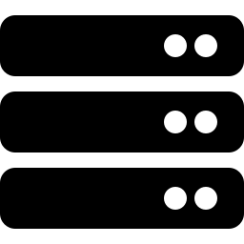

PROJECT CONTEXT
About AgriConnect
AgriConnect is a cloud-based agribusiness platform connecting smallholder and commercial farmers with buyers, traders, and logistics providers — while giving farmers tools to monitor farm conditions through low-cost IoT sensors.
WHO IT SERVES
Farmers
List produce, monitor farms via IoT, sell via app or USSD/SMS
Built on Week 1 discovery requirements — produce listing, buyer discovery and ordering, secure payments, delivery coordination, and real-time farm monitoring — the platform is designed as a layered, microservices-based architecture on public cloud infrastructure.
Buyers & Traders
Discover produce, place orders, track delivery
Logistics Partners
Coordinate delivery and shipment status
8
2
Independent
microservices
Access channels:
App & USSD/SMS
Platform Admins
Oversee analytics, compliance, and platform health
AgriConnect — Internship Presentation
3

Slide 4




WEEK 2 · DESIGN FOUNDATIONS
Four Guiding Architecture Principles
Inclusivity
Resilience to Intermittent Connectivity
Independent Scalability
Security & Trust
Core marketplace functions remain reachable by farmers on basic feature phones via USSD/SMS, not only smartphone users.
Mobile clients support offline data capture with background synchronization once connectivity resumes.
Marketplace traffic, sensor telemetry, and payments scale differently and are decoupled so a spike in one doesn't degrade another.
Financial transactions and farmer identity data require strong authentication, encryption, and auditability.
AgriConnect — Internship Presentation
4

Slide 5
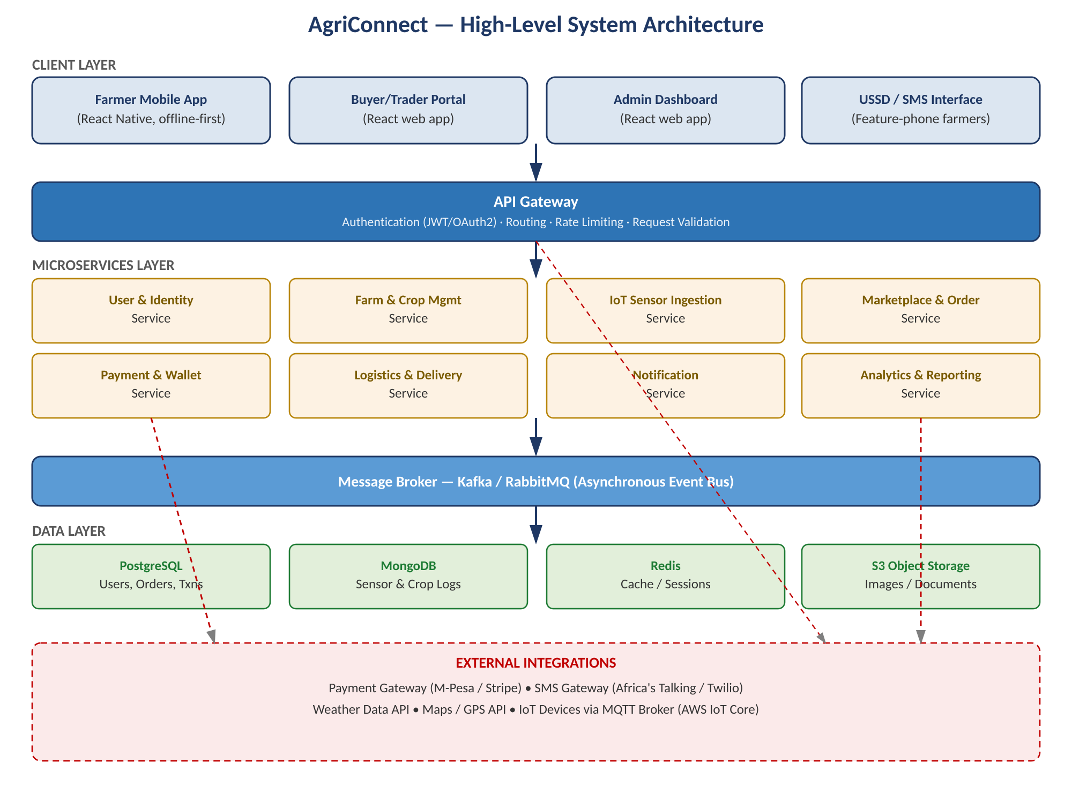
SYSTEM ARCHITECTURE
High-Level System Architecture
Five horizontal layers — client, API Gateway, microservices, message broker, and data — with external integrations shown separately since they are consumed by multiple services.
AgriConnect — Internship Presentation
5

Slide 6
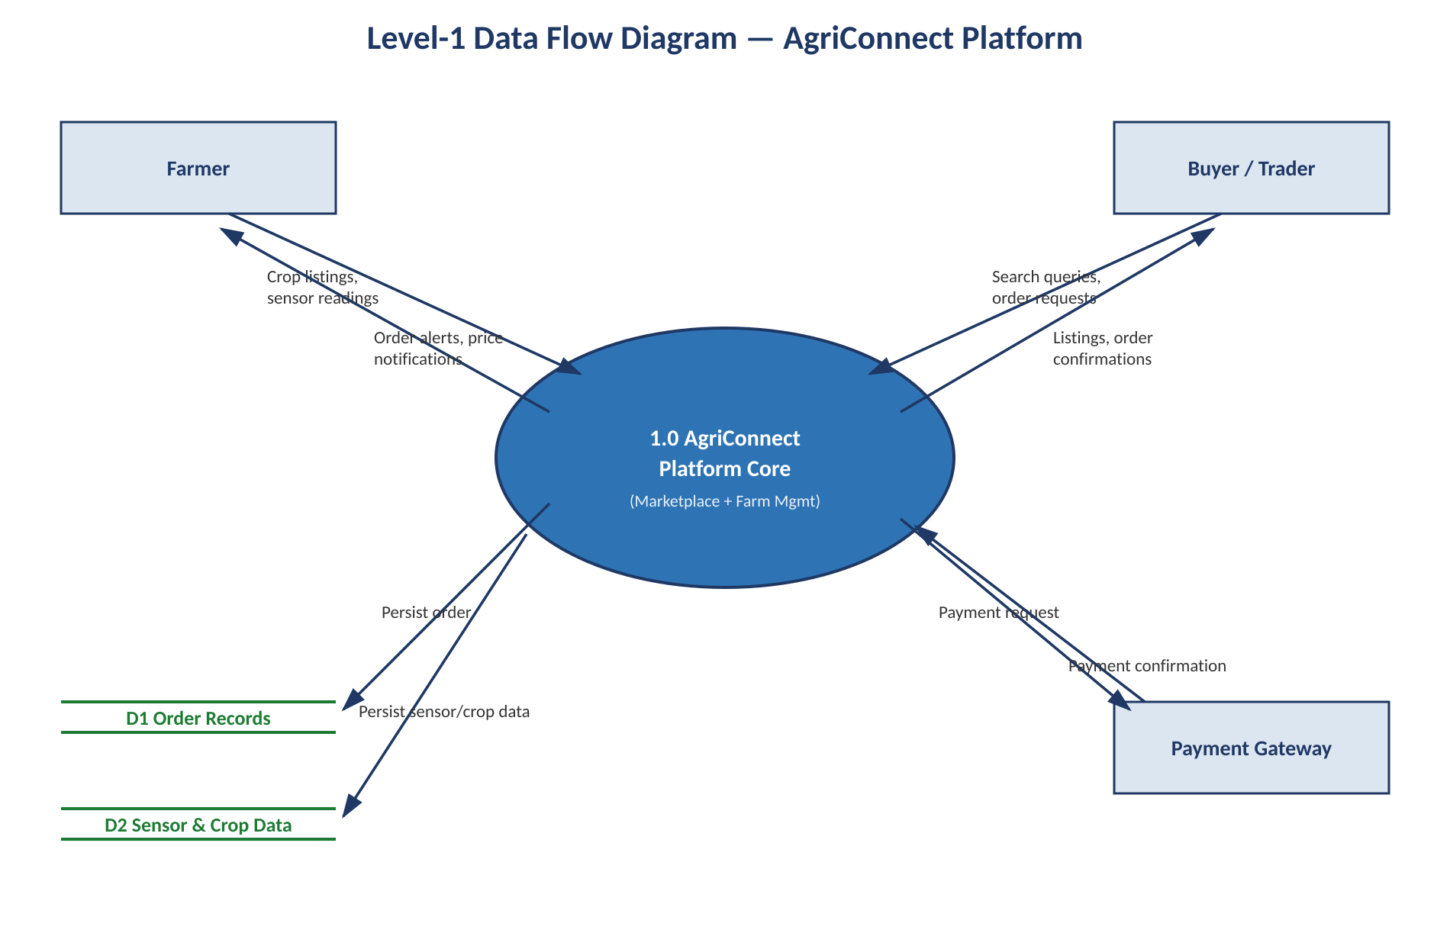
SYSTEM ARCHITECTURE
Level-1 Data Flow Diagram
Abstracts away service boundaries to show how information moves between the Farmer, Buyer/Trader, and Payment Gateway, and what is persisted to the two principal data stores.
AgriConnect — Internship Presentation
6

Slide 7
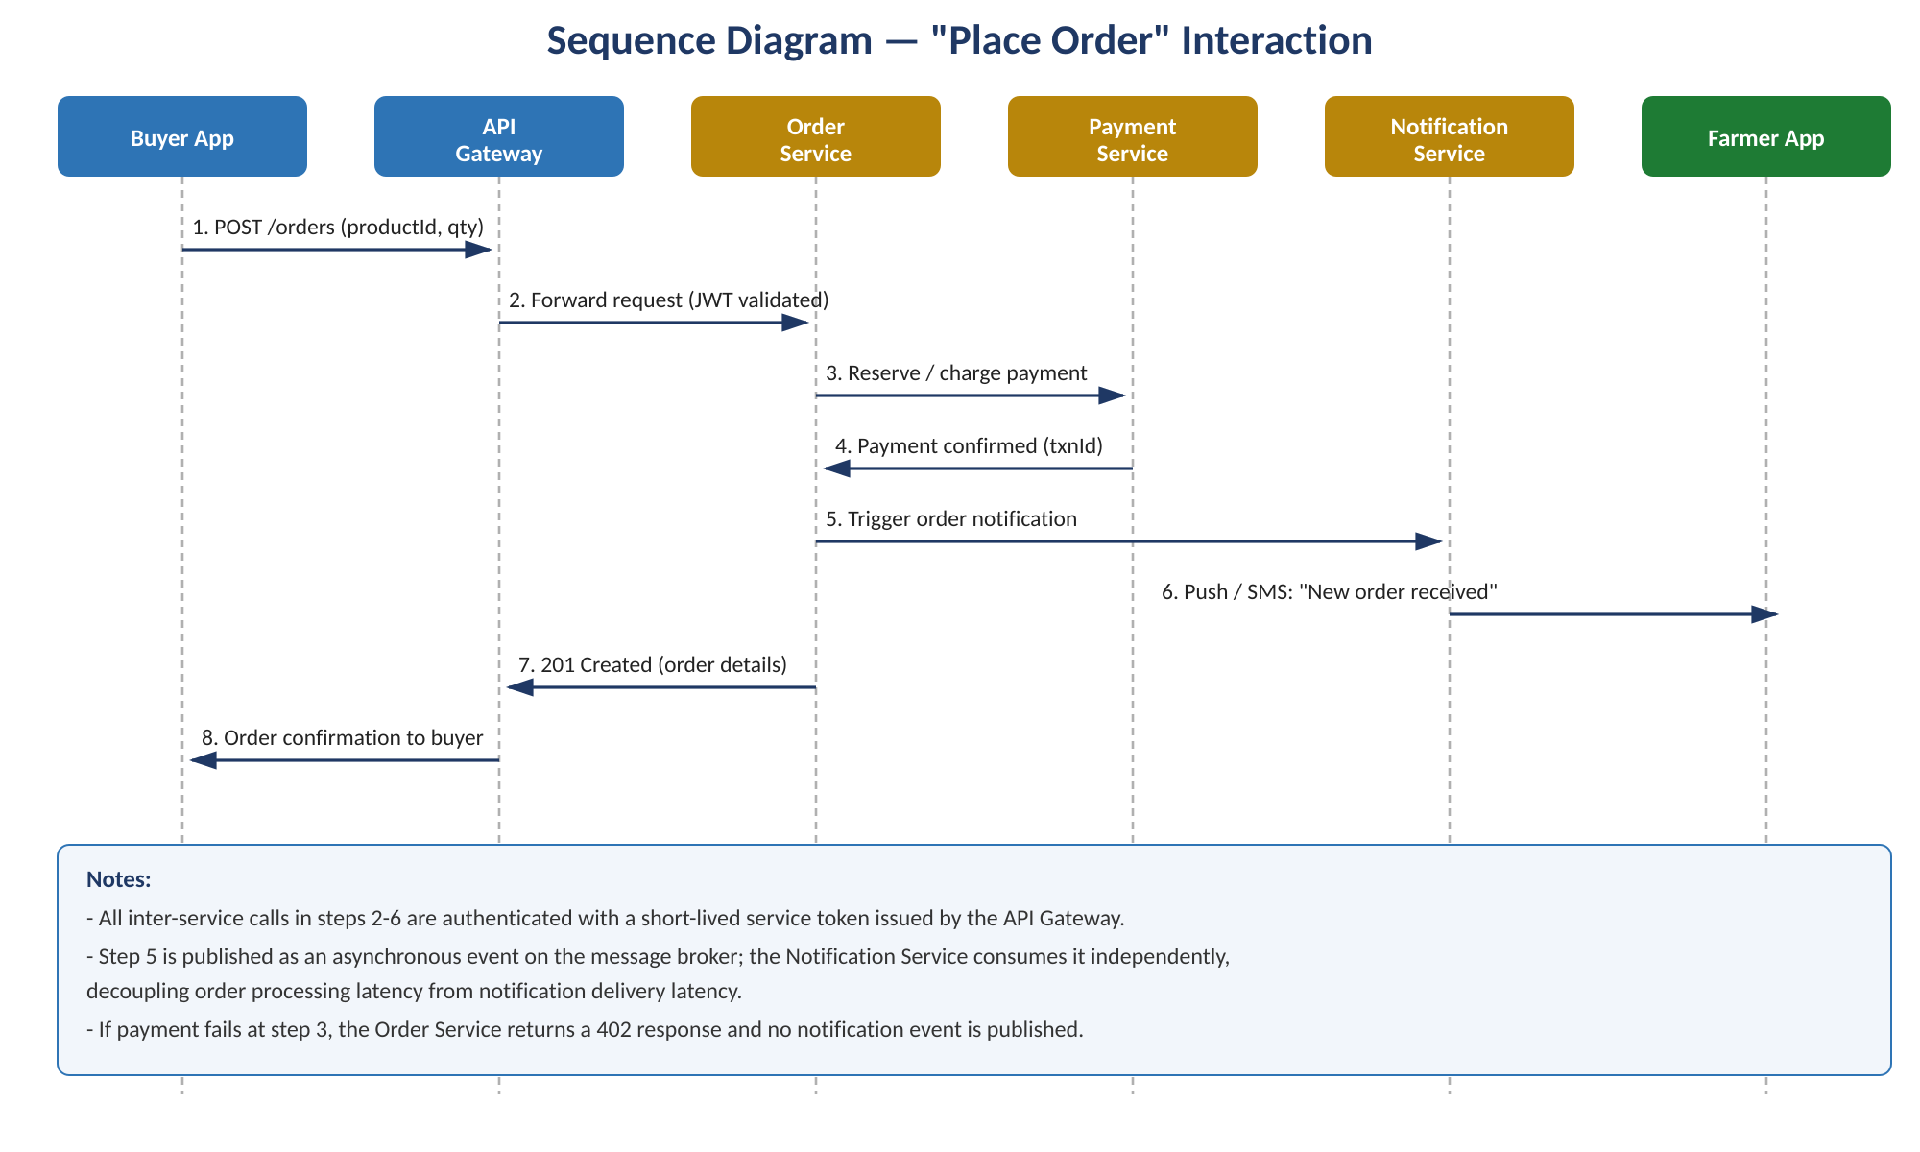
SYSTEM ARCHITECTURE
Component Interaction: "Place Order" Sequence
A representative user action — a buyer placing an order — traced end to end across the API Gateway, Order, Payment, and Notification services.
AgriConnect — Internship Presentation
7

Slide 8
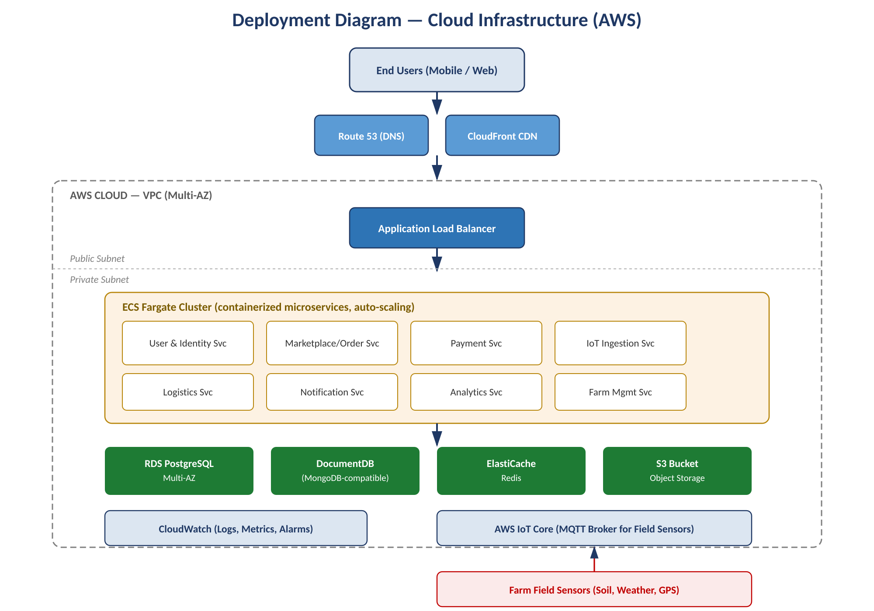
SYSTEM ARCHITECTURE
Cloud Deployment on AWS
Microservices run as containers on ECS Fargate in a private subnet, reachable only through the Application Load Balancer; IoT sensor traffic uses a separate ingestion path via AWS IoT Core.
AgriConnect — Internship Presentation
8

Slide 9
WEEK 2 · DESIGN FOUNDATIONS
Technology Stack & Justification
Choices were driven by affordability, low-connectivity support for rural users, and independent scaling of marketplace and IoT workloads.
Layer | Technology | Why
Mobile / Web Client | React Native + React.js | Shared patterns, offline-first sync for rural users
Low-Connectivity Access | USSD/SMS (Africa's Talking) | Reaches feature-phone farmers with no data plan
API Layer | Kong / AWS API Gateway | Centralized auth, throttling, routing
Backend Services | Node.js (Express) | Non-blocking I/O for high-concurrency workloads
Async Messaging | Apache Kafka / RabbitMQ | Decouples services; buffers bursty IoT data
Relational Data | PostgreSQL | ACID compliance for financial & order transactions
Document / Time-series | MongoDB | Flexible schema for sensor & crop-log data
Caching | Redis | Sub-millisecond reads for sessions & rate limits
IoT Connectivity | MQTT via AWS IoT Core | Lightweight, low-power protocol with device auth
AgriConnect — Internship Presentation
9

Slide 10
WEEK 2 · DESIGN FOUNDATIONS
Microservices & Module Responsibilities
Each microservice owns a single bounded context and exposes a versioned REST API (with one MQTT exception for sensor ingestion).
User & Identity
Farm & Crop Mgmt
IoT Sensor Ingestion
Marketplace & Order
Registration, auth, RBAC, profiles
Farm profiles, crop cycle tracking
Validates MQTT sensor payloads
Listings, cart, order lifecycle
Payment & Wallet
Logistics & Delivery
Notification
Analytics & Reporting
Payment init, wallet, payouts
Delivery scheduling & tracking
SMS, push, and email dispatch
Yield forecast, market trends
All REST endpoints are versioned under /api/v1/, require a bearer token issued by the User & Identity Service, and return errors in a consistent { code, message, details } JSON structure.
AgriConnect — Internship Presentation
10

Slide 11

WEEK 2 · DESIGN FOUNDATIONS
Integration Strategy
Internal Service Integration
External Integration
Synchronous REST over HTTPS for request/response interactions requiring an immediate result (e.g., submitting an order).
Payment providers (M-Pesa, Stripe) integrate only through the Payment & Wallet Service; callbacks verified via provider signatures.
Asynchronous events over Kafka/RabbitMQ where the originating service doesn't need to wait (e.g., notifications, analytics).
SMS/USSD gateway abstracted behind the Notification Service — switching providers needs no change elsewhere.
A shared OpenAPI specification is published per service so teams can generate client stubs and catch breaking changes early.
IoT devices authenticate via per-device X.509 certificates to AWS IoT Core before payloads reach the platform.
Weather & mapping APIs are cached in Redis to reduce cost and exposure to third-party outages.
AgriConnect — Internship Presentation
11

Slide 12




WEEK 2 · DESIGN FOUNDATIONS
Security Considerations
Auth & Access Control
Transport Security
OAuth2/JWT issued by User & Identity Service; RBAC enforced at gateway and re-validated per service.
TLS 1.2+ enforced on all traffic; the API Gateway rejects any unencrypted request.
Data Protection
Least-Privilege Network
PII and payment fields encrypted at rest (AES-256); secrets managed via a secrets manager.
Services and databases run in private subnets with security groups restricting access.
Input Validation
IoT Device Security
All inbound requests schema-validated at the gateway; per-client rate limiting mitigates abuse.
Unique certificate per field sensor; compromised devices disabled individually.
Auditability
Offline Data Integrity
All payment and order-state changes written to an append-only audit log.
Data captured offline is signed locally and validated on sync to detect tampering.
AgriConnect — Internship Presentation
12

Slide 13
WEEK 3 · PROTOTYPE DEVELOPMENT
Prototype Scope & Code Design
Two critical-path modules were implemented as working Node.js prototypes and validated with an automated unit-test suite, using plain, dependency-light JavaScript so logic — not framework wiring — stays the focus.
Marketplace & Order Service
IoT Sensor Ingestion Service
validateOrderInput, calculateOrderTotal, createOrder
validateSchema, validateRanges, normalizeSensorReading
Input validation, stock checking, volume-based discount calculation, and order creation — the logic behind steps 2–3 of the 'place order' sequence.
Rejects malformed or physically implausible sensor readings (e.g., soil moisture > 100%) before they reach the platform.
CODE DESIGN APPROACH
Functional Core
Custom Error Classes
Dependency Inversion
Pure functions for validation & calculation — no external-state mutation
OrderValidationError, InsufficientStockError, SensorPayloadError map cleanly to HTTP codes
Stock mutations isolated behind a repository interface for isolated unit testing
AgriConnect — Internship Presentation
13

Slide 14
WEEK 3 · PROTOTYPE DEVELOPMENT
Unit Testing Methodology & Results
30
100%
2
0
Automated tests
Statement / branch / line coverage
Test suites (Jest)
Failures on final run
METHODOLOGY
RESULTS BY MODULE
Each public function was tested against a representative valid case, one case per documented validation rule (boundary and invalid-type cases), and — for createOrder — an integration-style test verifying that a failed validation leaves no side effects. Tests use Jest's toThrow(ErrorClass) to verify the correct, specific error type.
Module | Tests | Coverage | Result
Order Service | 15 | 100% | PASS
Sensor Ingestion | 15 | 100% | PASS
Verification also included manual stress-testing (20 rapid input variations) and boundary re-checks after each fix.
Coverage gap closed: an empty/whitespace-only deviceId was initially untested (96.87% branch coverage) — a dedicated test case brought sensorIngestion.js to 100%.
AgriConnect — Internship Presentation
14

Slide 15


WEEK 3 · PROTOTYPE DEVELOPMENT
Challenges Encountered & Resolutions
Coverage Gap on Invalid deviceId
Floating-Point Precision
Symptom: No test supplied a present-but-empty deviceId.
Fix: Added a dedicated test case — closed the gap to 100% coverage.
Symptom: Discount math produced 474.99999999999994 instead of 475.
Fix: Introduced round2() to round at each intermediate calculation step.
Validation vs. Side-Effect Ordering
Error Granularity
Symptom: Malformed input could trigger a stock lookup before validation.
Fix: Reordered so validation always runs first; added a regression-guard test.
Symptom: A single generic Error made failures indistinguishable.
Fix: Introduced distinct error subclasses mapped to specific HTTP status codes.
AgriConnect — Internship Presentation
15

Slide 16

CONCLUSION
Key Takeaways
Requirements-Driven Architecture
Week 1 requirements translated directly into a layered microservices design with a single API Gateway and polyglot data layer matched to each service's data shape.
Fully Tested Prototype
30 automated tests across two critical-path modules pass with 100% statement, branch, function, and line coverage.
Production-Ready Patterns
Custom error classes and validation-before-side-effects ordering are designed to carry forward directly into the full Express/MongoDB implementation.
Next Phase: Full Express/MongoDB implementation of remaining microservices, building on the architecture and validated prototype patterns established in Weeks 2–3.
Thank You

